Slide 1


Residential Mitigation Techniques for the
Florida Homeowner
Presented and funded by a grant from the
Florida Division of Emergency Management, Residential Construction Mitigation Program

Slide 2
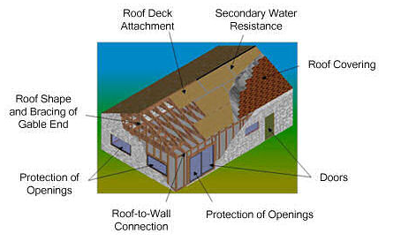
Typical Construction Features that Reduce Wind Damage and Loss
Notes:
Throughout this presentation we will be discussing those construction features that will contribute to reducing both wind and water damage to your home.
Protection of openings including windows and doors
Roof shape and gable-end bracing
Roof covering material
Roof deck attachment
Roof to wall connections

Slide 3
A. Installing Temporary Emergency
Shutters
Notes:
The proper installation of temporary emergency plywood panels can help protect your home from wind and water damage.
First, determine your homes wall construction – masonry, stucco, wood, brick – so that you purchase the proper fasteners and hardware.
Next, count and measure all openings in your home including windows, doors with glass such as French doors and sliding glass doors, and skylights.

Slide 4
“Do-It-Yourself “ Mitigation Techniques
The proper installation of temporary emergency plywood shutters can help protect your home from wind and water damage.
First, determine your home’s wall construction—masonry, stucco, wood, brick—so that you purchase the proper fasteners and hardware.
Next, count and measure all the openings in your home including windows, doors with glass such as French doors and sliding glass doors, and skylights.
Notes:
The proper installation of temporary emergency plywood panels can help protect your home from wind and water damage.
First, determine your homes wall construction – masonry, stucco, wood, brick – so that you purchase the proper fasteners and hardware.
Next, count and measure all openings in your home including windows, doors with glass such as French doors and sliding glass doors, and skylights.

Slide 5
Measure each opening horizontally inside the exterior trim and vertically from the sill to the bottom of the top trim.
If the window has an extended sill, measure from the sill to the top of the window trim.
Add 8” to both the height and width to provide a 4” overlap for fastening purposes.
Be sure to purchase exterior grade plywood that is 7/16 inches or greater.
Notes:
Measure each opening horizontally inside the exterior trim and vertically from the sill to the bottom of the trim.
If the window has an extended sill, measure from the sill to the top of the window trim.
Add 8 inches to both the height and width so that a four-inch overlap is created for fastening the panel.
Be sure to purchase exterior grade plywood of not less than 7/16 of an inch.

Slide 6
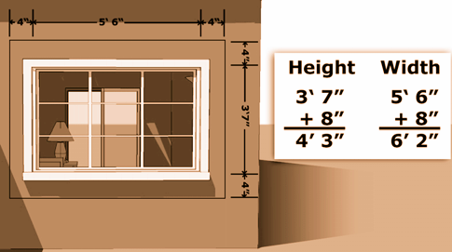
“Do-It-Yourself “ Mitigation Techniques
Measuring for Wood Panel Shutters
Notes:
Do-It-Yourself – Measuring for wood panel shutters.
Measure the window opening
Add 8 inches to both dimensions.
Cut the panel from a minimum of 7/16 inch exterior plywood. (CLICK)

Slide 7
Mark drill holes 2 inches from the edge of the plywood, at 12 inch intervals around the panel.
Drill marked holes the same diameter as the bolts.
Anchor the plywood panels around the opening and secure with bolts and fasteners in pre-drilled holes.
Anchors must be permanently installed on the residential structure.
If opening requires two panels, join panels with 2 x 4 bracing.
Notes:
Mark drill holes 2 inches from the edge of the plywood at 12 inch intervals around the panel.
Drill marked holes the same diameter as the bolts to be used for attaching the panels.
Anchor the plywood panels around the opening and secure with bolts and fasteners in the pre-drilled holes.
Anchors must be permanently installed on the residential structure.
If the opening requires two panels, join the panels with 2 x 4 bracing.

Slide 8
Mark each plywood panel with the opening location, such as “front bedroom window, left side” to ensure speedy installation.
Consider water-proofing the plywood panels or painting the panels to provide additional protection and longevity.
Notes:
After all the panels have been cut they should be marked indicating the specific location for which they were measured--for example “front bedroom window, left side”. This will ensure speedy installation.
You should also consider waterproofing the wood panels or painting them to provide additional protection and longevity.

Slide 9
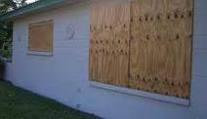
Plywood Shutter
Notes:
This photo shows plywood panels installed to protect the windows.

Slide 10
B. Gable-end Bracing Techniques
Notes:
Your house has a gable end if you have a sloped roof with a vertical wall that forms a triangle under the end of the roof as illustrated above by the red triangle.

Slide 11
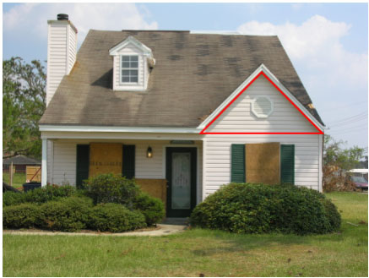
Gable-end Bracing Techniques
Your house has a gable end if you have a sloped roof with a vertical wall that forms a triangle under the end of the roof.
Notes:
Your house has a gable end if you have a sloped roof with a vertical wall that forms a triangle under the end of the roof as illustrated above by the red triangle.

Slide 12
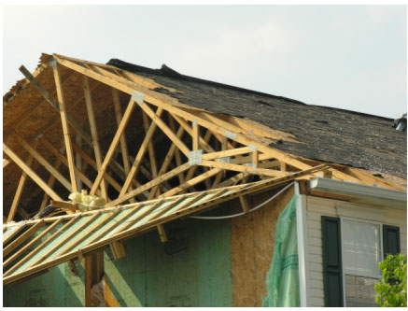
Gable-end walls and the roof sheathing at the gable end can take a tremendous beating during a hurricane, and if not properly attached and braced, they fail and cause catastrophic damage to your home.
Notes:
This photo shows a gable-end wall failure. Gable-end walls and the roof sheathing at the gable end can take a tremendous beating during a hurricane, and if not properly attached and braced, they fail and cause catastrophic damage to your home.

Slide 13
The number one issue with gable ends is the attachment of the roof sheathing at the gable end. If you have re-roofed and re-nailed the roof deck, you have gone a long way towards reducing damage at gable ends. If you have not strengthened the roof sheathing attachment, you can use adhesives to temporarily strengthen the sheathing attachment.
Most gable- end walls of older houses are weaker than they should be to withstand a hurricane and are poorly connected and braced.
Notes:
The number one issue with gabled ends is the attachment of the roof sheathing at the gable end. If you have reroofed or re-nailed your roof deck you’ve gone a long way toward reducing damage at the gable ends. If you have not strengthened the roof sheathing attachment you can use adhesives to temporarily strengthen the sheathing.
Most gable-end walls in older houses are weaker than they should be to withstand hurricane winds and are poorly connected and braced.

Slide 14
To strengthen and properly brace a gable-end wall you should:
Anchor and brace the bottom of the gable end's triangular wall to the ceiling joists or ceiling framing.
Strengthen the gable -end wall studs.
Brace the top of the gable-end wall by tying it to the rafters or tops of the trusses.
Notes:
To strengthen and properly brace gable ends you should:
Anchor and brace the bottom of the gable ends triangular wall to ceiling joists or ceiling framing;
Strengthen the gable-end wall studs;
Brace the top of the gable-end wall by tying it to the rafters or tops of the trusses.

Slide 15
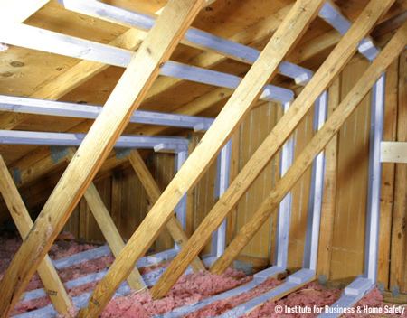
The light-colored framing shows completed gable-end bracing techniques.
Notes:
In this photograph, the new gable bracing materials have been highlighted. Notice additional vertical framing at the gable end and braces that connect to the existing roof and ceiling framing. This additional framing assists in transmitting the loads imposed on the gable end over more of the home’s structural system.

Slide 16
C. Securing Soffits
Notes:
One of the major water entry points during high winds is the home’s soffits. In order to minimize the loss of soffit material during high wind events the soffit should be attached as illustrated above.

Slide 17
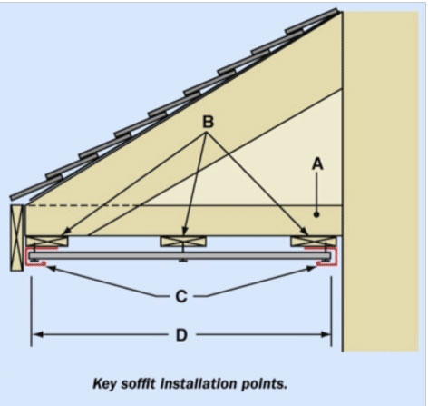
Securing Soffits
In order to minimize
loss of soffit material during high wind events, the soffit material should be attached as illustrated.
Notes:
One of the major water entry points during high winds is the home’s soffits. In order to minimize the loss of soffit material during high wind events the soffit should be attached as illustrated above.

Slide 18
Soffits should be attached to the roof framing at intervals not to exceed 12 inches both along and across the soffit.
If they are not, nailing strips should be installed to the roof framing to secure soffits.
A J-channel, F-channel or other receiver shall be installed at both the wall and the fascia ends of the soffit and attached as provided by the material manufacturer.
Vinyl soffits may be strengthened with urethane caulk.
Notes:
Soffits should be attached to the roof framing at intervals not to exceed 12 inches both along and across the soffit.
If they are not, nailing strips should be added to the roof framing so that the soffits may be secured.
A J or F channel or other type of receiver should be installed at both the walls and the fascia ends of the soffit and attached as provided by the soffit material manufacturer.
Vinyl soffits may also be strengthened using a urethane caulk.

Slide 19
D. Selecting Roof Coverings to Minimize
Wind-borne Debris & Water Damage

Slide 20
A home’s roof covering serves as a protective shield against wind and water intrusion.
Loss of the roof covering, such as asphalt shingles, clay tiles or metal panels makes your home more susceptible to water damage. Loose roofing material can become wind-borne debris that can damage other structures.
Be sure to select a roof covering that meets the wind-speed requirements for your local area.
If you are having an old roof replaced, your contractor should remove the existing shingles and underlayment rather than install new shingles over them. This approach allows the contractor to inspect the sheathing and make any repairs that may be necessary.
Notes:
A home’s roof covering serves as a protective shield against wind and water intrusion. Loss of the roof covering such as asphalt shingles, clay tiles or metal panels make your home susceptible to water damage. Loss of roofing material can also become windborne debris that can damage other structures.
When replacing the roof covering on your home be sure to select a roof covering that meets the wind speed requirements for the area in which you are located.
If you are having your old roof replaced, your contractor should remove all of the existing shingles and underlayment rather than installing new shingles over the existing roof. This approach allows the contractor to inspect the roof sheathing and make any repairs that may be necessary.

Slide 21
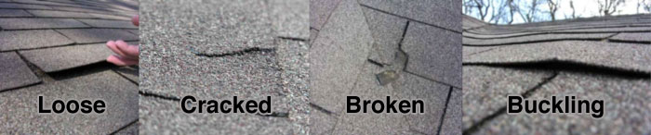
Homeowners should conduct a visual inspection of their home’s existing roof covering.
Examples of what to look for include broken tile, torn shingles, loose shingles or tiles, rusted or damaged metal panels, missing or rotted wood shingles and shakes.
Notes:
Homeowners should conduct a visual inspection of their home’s existing roof covering. The photo above shows shingles which are loose, cracked, broken or buckling. With tile roofs you should look for broken and loose tiles.

Slide 22
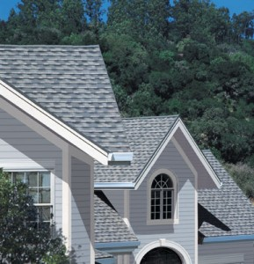
Asphalt Shingles
Asphalt shingles can be reinforced with organic material or fiberglass and fiberglass shingles have a life span of up to 20 years and a Class A fire rating.
Asphalt roof coverings should be tested and approved for ASTM D3161 or ASTM D 7158 for wind resistance and UL 2218 for impact resistance.
Asphalt shingles should be installed according to manufacturers instructions which will appear on the shingle bundle wrapper.
Notes:
Asphalt shingles are either reinforced with organic material or fiberglass and fiberglass shingles have a life span of up to 20 years as well as a Class A fire rating.
Asphalt roof covering shall be tested and approved in accordance with either ASTM D3161 or ASTM D7158 for wind resistance and UL 2218 for impact resistance.
Asphalt shingles should always be installed in accordance with the manufacturer’s instructions which can be found on the wrapper of the shingle bundles.

Slide 23
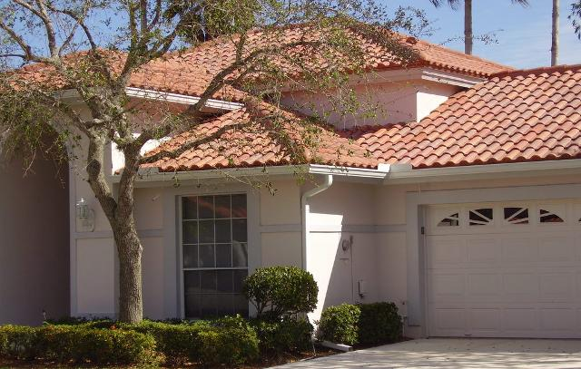
Clay or Concrete Tiles
Concrete tiles are more durable and can last as long as 30 years.
Clay tiles should be inspected regularly for chips and broken pieces as they tend to be more brittle.
Due to the complexities of proper roof tile installation, the installation of concrete and clay tiles should be left to a licensed roofing contractor.
Notes:
Concrete tiles are more durable and can last as long as 30 years.
Clay tiles should be inspected regularly for chips and broken pieces as they tend to be more brittle.
Due to the complexities of the proper installation of roof tiles they should be installed by a licensed roofing contractor.

Slide 24
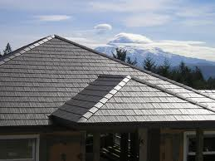
Metal Roof Coverings
Gaining popularity in recent years, metal roofing material, which is lightweight, has an expected life span of up to 40 years.
Metal roof covering usually has a Class A fire rating.
The preferred method of installation in high-wind areas is to utilize clips or cleats so that the fasteners are not exposed to weather, thus limiting the chance for buckling.
  Fasteners should be corrosion resistant and penetrate the sheathing .
Notes:
Gaining popularity in recent years, metal roofing material, which is lightweight has a life span of up to 40 years.
Metal roof coverings usually have a Class A fire rating.
The preferred method of installation in high wind areas is to utilize clips or cleats so the fastening is not exposed to the weather, thus limiting the chance of buckling.
Fasteners should be corrosive-resistant and penetrate the roof sheathing.

Slide 25
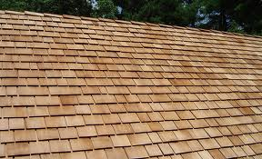
Wood Shingles and Shakes
Wood shingles and shakes are made from cedar, southern pine or other wood.
Some local ordinances restrict the use of wood shingles and shakes.
Unless fire-retardant treated, wood shingles and shakes do not provide adequate protection against wildfires.
Notes:
Wood shingles and shakes are made from cedar, southern pine or other would.
Some local ordinances restrict the use of wood shakes and shingles because of the potential fire hazard. Unless fire retardant-treated, would shingles and shakes do not provide adequate protection against wildfires.

Slide 26
E. Roof Sheathing & Decking

Slide 27
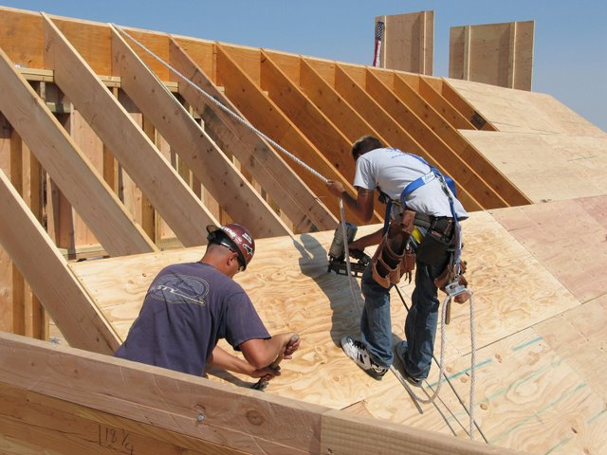
Roof Sheathing & Decking
Roof sheathing or decking is the layer of a roof that is used as the base for roof coverings to be nailed to, is underneath the roof covering and membrane layers and it covers the roof trusses or rafters. The sheathing layer also acts as another layer of protection for the roof.
Sheathing usually consists of plywood, oriented strand board (OSB) or dimensional lumber planks.
Radiant barrier sheathing has an aluminum side which faces down into the attic, and reflects the heat that comes from the roof.
Notes:
Roof sheathing or decking is the layer of the roof that is used as the base for the roof covering to be nailed to, is underneath the roof covering and membrane layer, called underlayment, and it covers the roof trusses or rafters. The sheathing layer also acts as another layer of protection. Roof sheathing usually consists of plywood, oriented strand board (OSB) or dimensional lumber planks.
Radiant barrier sheathing has an aluminum side which faces down into the attic, and reflects the heat that comes from the roof.
The photo shows sheathing being attached to the roof framing.

Slide 28
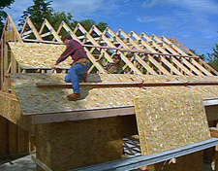
Oriented-Strand Board Roof Sheathing
Notes:
The photo above is of oriented-strand board sheathing.

Slide 29
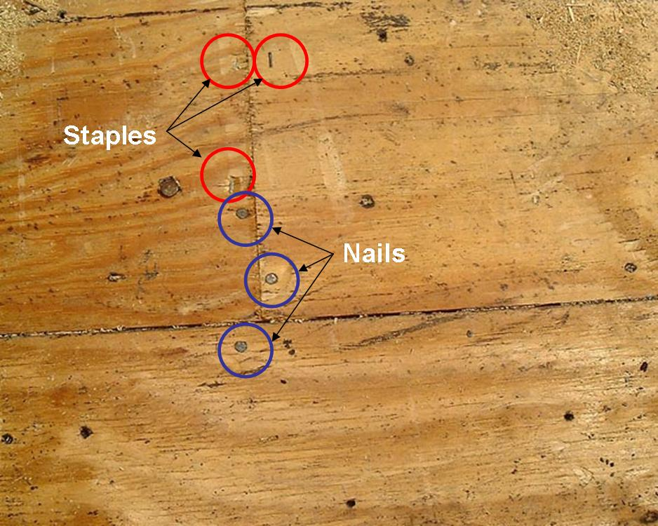
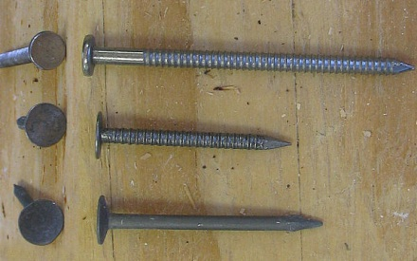
Roof sheathing should be installed using 8d round head, clip head or ring- shank nails spaced at 6 inches on center at every roof framing member.
The minimum thickness for roof sheathing is 7/16 inch, but most insurers recommend a minimum of 5/8 inch.
Ring shank nails
Notes:
Roof sheathing should be installed using a minimum 8d round head, clip head, or ring shank nails spaced 6 inches on center at every roof framing member.
The minimum allowable thickness for roof sheathing in the code is 7/16 of an inch, but most insurers recommend a minimum 5/8 inch.

Slide 30
F. Roof Flashing

Slide 31
Flashing
For pitched roofs the purpose of flashing is to direct the flow of water that leaks into the intersection down and away from the interior of the structure.
Valley flashing protects the valleys where two roof planes meet.
Step flashing protects the joints between the roof deck and chimneys or dormers.
Vent pipe flashing fits over flues or pipes. The shape of vent flashing is typically a cylinder with a wide flange at the base, which is lapped into the shingles as the roofing is installed.
Drip edges are strips of flashing material that run along roof eaves and rakes to prevent water from seeping under the finished roof along its edges.
Notes:
For pitched roofs the purpose of flashing is to direct the flow of water that leaks into the intersection down and away from the interior of the structure.
Valley flashing protects the valleys where two roof planes meet.
Step flashing protects the joints between the roof deck and chimneys or dormers.
Vent pipe flashing fits over flues or pipes. The shape of vent flashing is typically a cylinder with a wide flange at the base, which is lapped into the shingles as the roofing is installed.
Drip edges are strips of flashing material that run along roof eaves and rakes to prevent water from seeping under the finished roof along its edges.

Slide 32
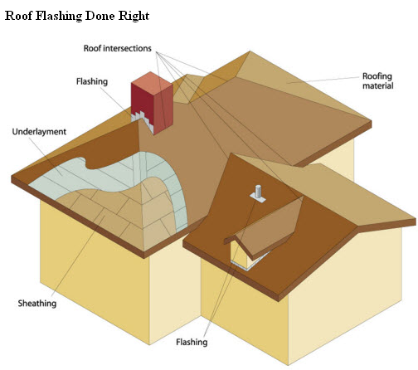
Flashing
Roof Flashing Recommendations
• Always lap flashing and other
moisture barriers properly.
• Do not rely on sealant as a s
substitute for proper lapping.
• Use fasteners that are compatible with the flashing material.
• Use flashing cement at joints to help secure flashing.
At roof-to-wall intersections:
Use step flashing that has a 4-inch vertical leg.
Tape the top of step flashing with 4-in. wide self-adhering modified bitumen tape.
Do not seal house-wrap or building paper to step flashing.
Notes:
Roof Flashing Recommendations
• Always lap flashing and other moisture barriers properly.
• Do not rely on sealant as a substitute for proper lapping.
• Use fasteners that are compatible with the flashing material.
• Use flashing cement at joints to help secure flashing.
At roof-to-wall intersections:
Use step flashing that has a 4-inch vertical leg.
Tape the top of step flashing with 4-in. wide self-adhering modified bitumen tape.
Do not seal house-wrap or building paper to step flashing.

Slide 33
G. Hurricane Clips & Straps

Slide 34
Hurricane Clips & Straps
As part of strengthening your home, where possible the roof framing needs to be connected to the wall below it. This is typically accomplished with galvanized metal plates commonly referred to as “hurricane clips or straps.”
Clips and straps are typically installed whenever the roof sheathing is removed or may be installed from the exterior by removing the soffit and connecting the roof framing to the wall below or accessing the space from inside the attic.
Notes:
As part of strengthening your home, where possible roof framing needs to be connected to the wall below it. This is typically accomplished with galvanized metal plates commonly referred to as hurricane clips or straps.
Clips and straps are typically installed when the roof sheathing is removed but in existing homes may be installed from the exterior by removing the soffit and connecting the roof framing to the wall below or by accessing the space from inside the attic.

Slide 35
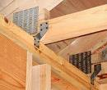
Illustrations of hurricane clips and straps. Hurricane clips attach to one side only, while hurricane straps wrap over the framing member and attach on both sides.
Hurricane Clip
S
T
R
A
P
S
Notes:
The illustrations above show both hurricane clips on the left and straps in the two photos on the right. Hurricane clips typically attach on one side of the framing only while straps will wrap over the frame member and should be nailed on both sides.

Slide 36
H. Securing Opening Protection

Slide 37
Securing Opening Protection
One easy method for mitigating your home against storm damage is to secure your window and door openings.
Exterior doors, garage doors and windows should all be inspected for broken or damaged brackets, hinges and handles.
To reduce potential water intrusion, caulk and weather-strip all doors and windows.
Protection of garage doors may be enhanced by installing a bracing kit to provide vertical and horizontal strength against high winds.
Garage door rollers should also be checked.
Notes:
One easy method for mitigating your home against storm damage is to secure your window and door openings.
Exterior doors, garage doors and windows should all be inspected for broken or damage brackets, hinges and handles.
To reduce potential water intrusion, caulk and weather-strip all doors and windows.
Protection of garage doors may be enhanced by installing a bracing kit to provide both vertical and horizontal strength during high winds. Additionally, garage door rollers should be checked.

Slide 38

Securing Opening Protection

Slide 39
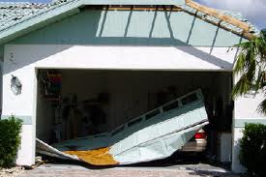
When a garage door fails, it provides not only an entry point for water, but also allows for the wind to get under the roof and lift it off the structure.
Notes:
When the garage door fails, it provides not only an entry point for water, but allows for the wind to get under the roof and lift it off the structure. The photo above shows the importance of having proper support and bracing for a garage door.

Slide 40
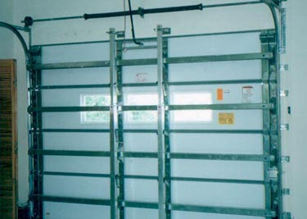
Garage Door Bracing Components
Added Vertical Brace
Added Horizontal Braces
Notes:
The photo above shows the installation of a commercially available garage door bracing kit. Notice both horizontal bracing elements and vertical braces have been added to the garage door. The garage door can be replaced with an impact-resistant garage door designed to withstand the wind pressure for the area in which the home is located. New garage doors are required to be labeled indicating what design pressure for which they were approved.

Slide 41
I. Storm Preparation & Landscaping Tips to Mitigate Damage

Slide 42
Storm Preparation & Landscaping Tips to Mitigate Damage
Remove any outdoor items that may become wind-borne debris: children’s toys, pool and patio furniture, planters, lawn equipment, etc.
Trim tree limbs and branches that extend over your home’s roof and trim and anchor foliage.
Replace gravel that could become wind-borne debris with landscaping mulch.
Clean gutters to prevent water damage and ensure gutters are secure to the house.
Notes:
Other storm preparation and landscaping tips to minimize damage:
Remove any outdoor items that may become windborne debris: children’s toys, pool and patio furniture, planters, lawn equipment etc.
Trim tree limbs and branches that extend over your home’s roof and trim and anchor foliage.
Replace gravel which could become windborne debris with landscaping mulch.
Clean gutters to prevent water damage and check to ensure gutters are properly attached to the house.

Slide 43
If you have a swimming pool, do not empty your pool before the storm. Keeping sufficient water levels in your pool provides the important weight to hold the sides and bottom in place.
To prevent water damage to surrounding structures, you may reduce the pool’s water level by 1-2 feet.
You should super chlorinate your pool prior to the storm.
Turn off all electrical pool equipment. All exposed electrical equipment such as pump motors should be tightly covered with plastic wrap.
Remove all loose items—pool furniture, toys, pool equipment.
Notes:
If you have a swimming pool, do not empty your pool before a storm. Keeping sufficient water levels in your pool provides the important weight to hold the sides and bottom in place.
To prevent water damage to surrounding structures, you may reduce the pool water level by 1 to 2 feet.
You should super chlorinate or “shock” your pool prior to the storm.
Turn off all electrical pool equipment. All exposed equipment such as pump motors should be tightly covered with plastic wrap.
Remove all loose items; pool furniture, toys, and loose pool equipment.

Slide 44
A key ingredient for storm preparation is to create a storm kit that includes a three-day supply of food for your family and adequate pet supplies.
The storm kit should also include a battery-powered radio, flashlight, extra batteries, car charger for your cell phone and a manual can opener.
Be sure to include cash and important documents in your storm kit, such as insurance papers, birth certificates, passports, and important phone numbers.
Have a family disaster plan—know your evacuation route and locations of local shelters.
Notes:
A key ingredient for storm preparation is to create a storm kit that includes a three-day supply of food for your family and adequate pet supplies.
The storm kit should include a battery-powered radio, flashlight, extra batteries, car charger for your cell phone and a manual can opener.
Be sure to include cash and important documents in your storm kit, such as insurance papers, birth certificates, passports, and important phone numbers.
Have a family disaster plan and know your evacuation route and the location of local storm shelters.

Slide 45
Wind Mitigation Measures A Contractor May Perform for the Homeowner

Slide 46
A. Opening Protection Devices

Slide 47
A. Opening Protection Devices
Protecting your home’s openings is critical in order to prevent water and wind damage from severe storms.
A registered, licensed contractor can assist with correct installation of impact-resistant products to safeguard your home’s windows, exterior doors, skylights and garage doors.
Impact-resistant products are manufactured to meet wind-resistant measures and design pressure ratings.
Notes:
Mitigation measures a contractor may perform for the homeowner.
Opening protection devices
Protecting your home’s openings is critical in order to prevent water and wind damage from severe storms.
A registered, licensed contractor can assist with the correct installation of impact-resistant products to safeguard your home’s windows, exterior doors, skylights and garage doors.
Impact-resistant products are manufactured to meet wind-resistant measures and design pressure ratings

Slide 48
Your contractor will help you select opening protective devices that adhere to the wind-speed, wind pressure cyclic testing and design pressure requirements for your location consistent with the Florida Building Code and Florida Product Approval system.
In order to qualify for mitigation property insurance discounts, your insurance company may require documentation indicating compliance with the Florida product approval system.
Notes:
Your contractor will help you select the opening protective devices that adhere to the wind speed and wind cyclic pressure testing as well as the design pressure requirements of the Florida Building Code for your location and those products that have been approved under the Florida product approval system.
In order to qualify for mitigation property insurance discounts, your insurance company may require documentation that the protection products you are using comply with the Florida product approval system.

Slide 49
Impact- Rated Glazed Products
Impact rated glazed products must also be labeled.
Notes:
This slide illustrates the construction and labeling of “Impact Glass”
Note the 2 layers of glass that sandwich a polyvinylbutyral interlayer. The window frame has an extra wide bed flange and then is sealed with a special wet glazing.
As of 2009, the Florida Building Code requires all impact glass to have a label etched into the glass.

Slide 50
B. Installing Shutters for Opening Protection

Slide 51
B. Installing Shutters for Opening Protection
Preventing your home from wind and water damage is critical to your home’s survival. Shutters can provide a protective barrier by:
Keeping wind pressure from building up inside, which often leads to loss of the roof;
Reducing the chance glass will break;
Reducing the chance of wind-driven rain from soaking the home’s interior.
Notes:
Preventing your home from wind and water damage is critical to your home’s survival. Shutters can provide a protective barrier by:
Keeping wind pressure from building up inside which often leads to loss of the roof;
Reducing the chance the glass will break;
Reducing the chance of wind or rain soaking the interior of the home.

Slide 52
On average, the area to be shuttered –windows and doors with glass--is about 15 percent of the home’s total square footage. For example, a 2,000 sq. ft. home would require about 300 sq. ft. to be covered by shutters.
The estimated cost to shutter a 2,000 sq. ft. home with a product that costs $20 per sq. ft. is:
300 sq. ft. X $20=$6,000.
In today’s market, the vast range of products makes it easy to find protection that fits your budget.
Commercially-installed shutters typically cost between $9 and $30 per square foot of openings. The costs increase for motorized units.
Notes:
On average, the area to be shuttered--windows and doors with glass-- is about 15% of the home’s total square footage. For example, a 2000 sq.ft. home would require approximately 300 sq. ft. of shutters.
The estimated cost of shutters for a 2000 square foot home with a product that cost $20 a square foot would be about approximately $6,000 dollars.
In today’s market the vast range of products makes it easy to find protection that fits your budget. Commercially-installed shutters typically cost between $9.00 and $30.00 per square foot of opening. Naturally, motorized units cost considerably more.

Slide 53
Choose a shutter with the proper approval rating for
impact-resistance.
Know that just because a product is labeled “hurricane tested” does NOT mean it has passed the large-missile impact tests.
Look for these ratings:
Florida Building Code TAS 201, 202, 203
ASTM E 1886 and 1996-03
Miami-Dade Protocols PA 201, 202, 203
Notes:
Choose a shutter with the proper rating for impact resistance. Know that just because a product is labeled hurricane tested does not mean that it has passed the large-missile impact test.
Look for products that indicate they have been tested to one of the following:
1 Florida Building Code TAS 201, 202, 203 or;
2. ASTM E 1886 and 1996-03 or;
3. Miami-Dade protocols PA 201, 202, 203

Slide 54
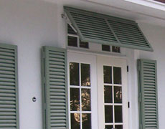
Various Shutters for Opening Protection
There are generally four types of shutters available that must be installed by a licensed contractor: colonial, full view Bahamas, roll-down and accordion.
Colonial Shutters
Notes:
There are generally four types of shutters available that must be installed by a licensed contractor: colonial, full view Bahamas, roll-down, and accordion.
The picture shown is of a typical colonial shutter.

Slide 55
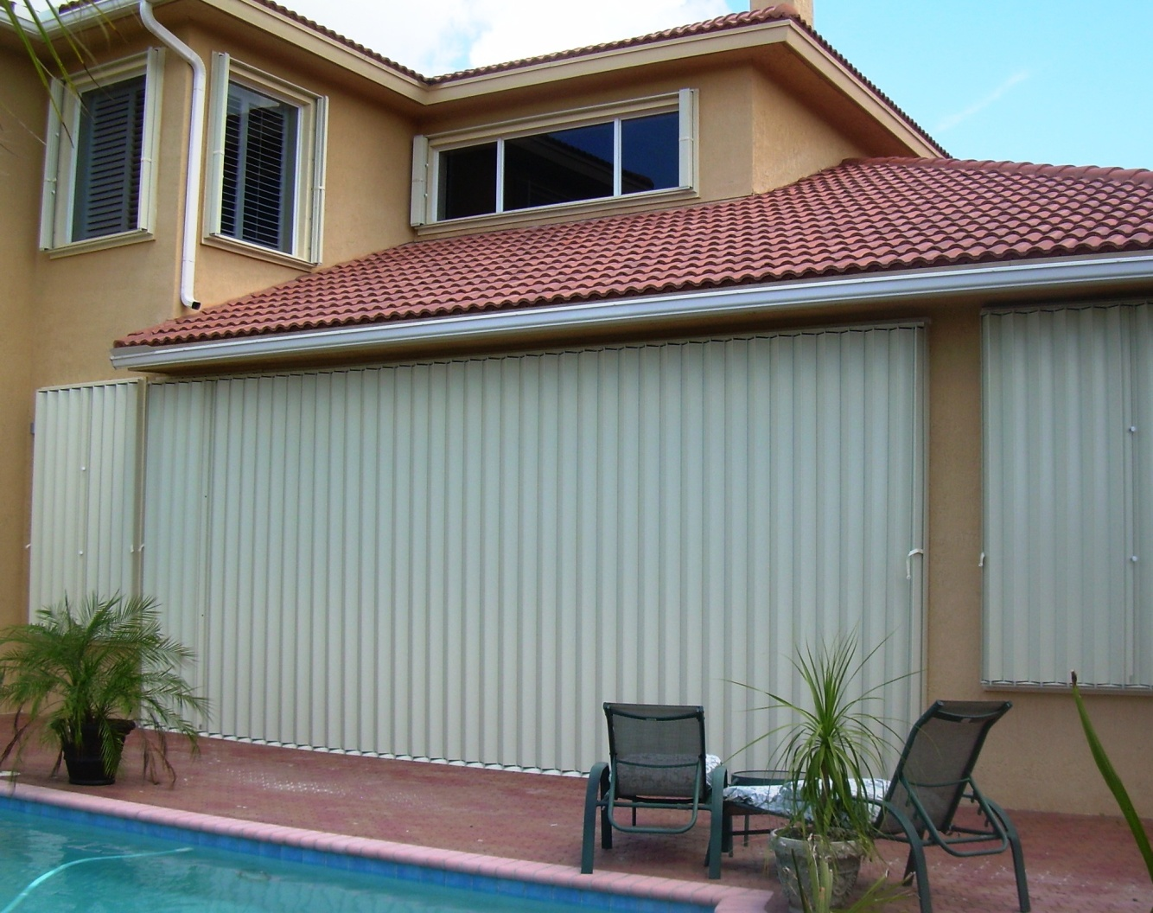
Accordion shutters are typically used to cover sliding glass doors or other large openings.
Notes:
Accordion shutters are typically used to cover sliding glass doors or other large openings but may be used to protect any opening.

Slide 56
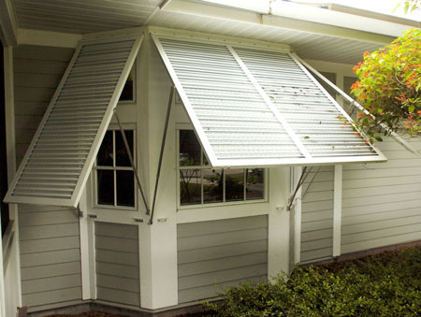
Colonials tend to be more decorative while Bahamas tend to offer better air and light circulation.
Notes:
The illustration above is of a Bahamas shutter. Unlike Colonial shutters Bahama shutters tend to restrict both air and light circulation.

Slide 57
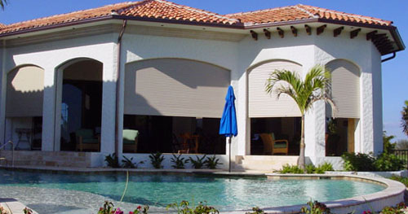
Roll Down shutters can be either hand cranked or motorized and tend to run the most expensive.
Notes:
The picture above is of roll down shutters which can be either hand-cranked or motorized and tend to be the most expensive.

Slide 58
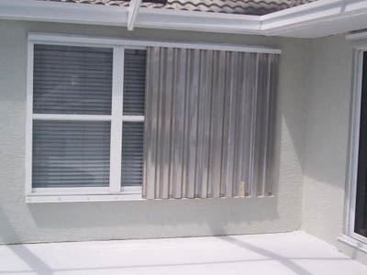
Another option for hurricane protection are panels, which tend to cost significantly less in price per square foot.
Notes:
Another option for hurricane protection is panels which tend to cost significantly less on a price per square foot basis. Hurricane protection panels may be of steel, aluminum or a clear polycarbonate plastic.

Slide 59
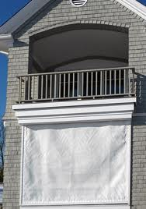
Fabric Shutter
Another product option
is fabric shutters that
meet the Florida Building Code.
Notes:
Another option is fabric shutters and there are a number of different manufacturers that produce fabric shutters that have been approved in accordance with the Florida Building Code.

Slide 60
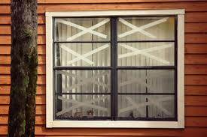
Masking Tape or Duct Tape Are Not Approved Mitigation Measures

Slide 61
C. Hip Roofs vs. Gable-end Roofs & Proper Bracing

Slide 62
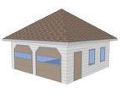
C. Hip Roofs vs. Gable-end Roofs & Proper Bracing
Hip shaped roofs are less l are less likely to peel off in high force winds.
Wind pressures on a hip-shaped roof are lower than on a gable-shaped roof during the same storm.
However, if your home has a gable shape or slope, your licensed contractor can retrofit your roofing system to mitigate against wind uplift that could tear apart the roof covering and roof deck.
The next 3 slides illustrate retrofit gable-end bracing that your contractor can do.
Notes:
Roof shape can affect building performance during wind events. Hip- shaped roofs are less likely to peel off during high winds. The wind pressure is much lower with a hip roof than on a gable roof during the same storm. If you have a gable-shaped roof a licensed contractor can mitigate your roofing system against wind uplift that could tear apart both the roof covering and the roof deck.
The next three slides illustrate the retrofit of gable-end bracing that your contractor can provide.

Slide 63


Gable End Retrofit Components
Existing Gable End Stud
Existing Roof System
Roof Framing
Compression Blocks
New Horizontal Brace
Existing Ceiling System
New Retrofit stud
Notes:
This illustration is being provided to show the components that makeup the retrofit gable-end bracing.

Slide 64
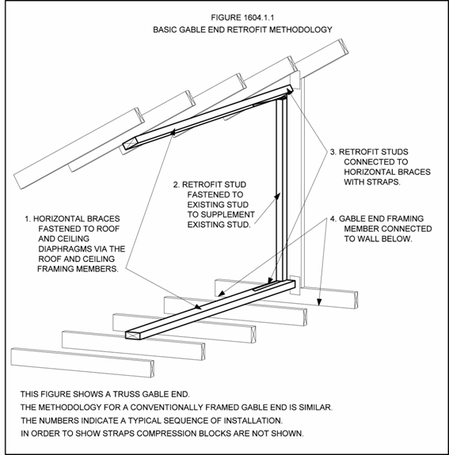
Basic Gable End Retrofit Methodology
2. Retrofit stud fastened to existing stud to supplement existing stud.
3. Retrofit studs are connected to horizontal braces with straps.
1. Horizontal braces fastened to roof and ceiling diaphragms via the roof and ceiling members
4. Gable-end framing member connected to wall below.
Notes:
This figure shows a gable truss end. The methodology retrofitting truss framed gable end. The numbers show a typical sequence of installation; however, in order to show straps, the compression blocks are not shown.
1. Horizontal braces fastened to roof and ceiling diaphragms via the roof and ceiling members;
2. Retrofit stud fastened to existing stud to supplement existing stud;
3. Retrofit studs are connected to horizontal braces with straps;
4. Gable-end framing member connected to wall below.

Slide 65
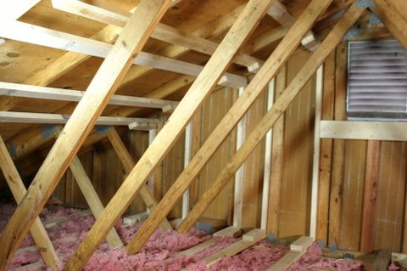
3. Compression
Block
2. Retrofit Stud
1. Horizontal Brace
3. Compression
Block
Notes:
Photograph is of an actual gable-end bracing job after it was completed.
The new material is labeled and the location identified.

Slide 66
D. Secondary Water Barriers

Slide 67
Secondary Water Barriers
Secondary water barriers provide a seal in all of the cracks and joints between the individual roofing panels in the event of the loss of the primary roof, tiles, shingles or metal panels, thus preventing additional water intrusion.
Your contractor should install a roof deck of 5/8” thick solid plywood to maximize wind and windborne debris resistance with 10d or 8d ring shank common nails spaced 4 inches along the panel edges and every six inches in the field of the plywood panel. Make sure the nails penetrate the decking directly into the roof framing.
In your existing home, be sure to look in the attic to confirm that the roof decking is properly nailed to the roof framing. If you can see nails along the sides of rafters or trusses where the nail penetrates the decking, your roof deck may not be securely attached.
Notes:
A secondary water barrier is a construction method that provides seal and all joints of the roof sheathing.
In the event of loss of the roof covering, that is the shingles, tile or metal panels, the seal prevents water from entering the structure.
Your contractor should install a roof deck of 5/8” thick solid plywood to maximize wind and windborne debris resistance with 10d or 8d ring shank common nails spaced 4 inches along the panel edges and every six inches in the field of the plywood panel. Make sure the nails penetrate the decking directly into the roof framing.
In your existing home, be sure to look in the attic to confirm that the roof decking is properly nailed to the roof framing. If you can see nails along the sides of rafters or trusses where the nail penetrates the decking, your roof deck may not be securely attached.

Slide 68
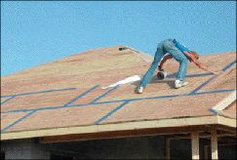
Secondary Water Barrier
Self- adhering polymer modified bitumen tape (Peel & Stick)
Notes:
Illustration of the installation of a peel & stick secondary water barrier before the roof covering is applied.

Slide 69

Secondary Water Barrier - IBHS Video

Slide 70
Create a secondary water barrier by installing self-adhering flashing tape or modified polymer bitumen strips, commonly called peel and seal, over the joints in your roof deck. This will help keep out the rain in the event the roof covering is damaged or destroyed by severe weather.
Install one layer of #30 underlayment, sometimes called felt paper, over the roof decking and secondary water barrier. The felt helps with drainage in the event water gets under the roof covering.
All nails used to attach the roof sheathing must penetrate the underlying roof trusses, otherwise it will not be securely attached and can be more easily torn away by high winds.
You can significantly increase the roofs resistance to uplift from the wind by applying a bead of construction adhesive using a caulking gun along both sides of the intersection of the roof decking and the rafters or trusses. Be sure to look for a premium, APA AFG-01 rated adhesive.
Notes:
Create a secondary water barrier by installing self-adhering flashing tape or modified polymer bitumen strips, commonly called peel and seal, over the joints in your roof deck. This will help keep out the rain in the event the roof covering is damaged or destroyed by severe weather.
Install one layer of #30 underlayment, sometimes called felt paper, over the roof decking and secondary water barrier. The felt helps with drainage in the event water gets under the roof covering.
All nails used to attach the roof sheathing must penetrate the underlying roof trusses, otherwise it will not be securely attached and can be more easily torn away by high winds.
You can significantly increase the roofs resistance to uplift from the wind by applying a bead of construction adhesive using a caulking gun along both sides of the intersection of the roof decking and the rafters or trusses. Be sure to look for a premium, APA AFG-01 rated adhesive.

Slide 71
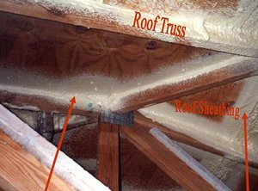
Secondary Water Barrier Spray
Adhesive Foam
foam polyurethane coating
Notes:
For existing homes, this is an illustration of a secondary water barrier applied using a polyurethane foam coating applied to the underside of the roof deck.

Slide 72
E. Securing Foundations & Proper Roof, Wall & Floor Connections

Slide 73

E. Securing Foundations & Proper Roof, Wall & Floor Connections

Slide 74
F. Mechanical Equipment Tie-Down

Slide 75
F. Mechanical Equipment Tie-down
Another mitigation technique your contractor can perform is to secure your air-conditioning equipment.
Air-conditioning equipment shall be anchored to the structure or a concrete slab to prevent overturning from wind forces.
Roof-mounted equipment shall be attached to the structure.
Ground-mounted condensing units shall be either screwed or strapped to the slab on which they are located.
Notes:
Another mitigation technique your contractor can perform is to secure your air-conditioning equipment.
Air-conditioning equipment shall be anchored to the structure or a concrete slab to prevent overturning from wind forces.
Roof-mounted equipment shall be attached to the structure.
Ground-mounted condensing units shall be either screwed or strapped to the slab on which they are located.

Slide 76
Florida Department of Business and
Professional Regulation

Slide 77

How to Verify A Contractor’s License
To verify a contractor’s license call:
1-850-487-1395
or go to the Department’s website: www.MyFlorida License.com
Verify License Holder
Notes:
At the “Florida Department of Business and Professional Regulation” you can verify whether an individual has a current license by either calling the DBPR Call Center at 850-487-1395 or go online at their website: www.myfloridalicense.com.
For the website just click on the “VERIFY A LICENSE” link at the top of the page and…. CLICK

Slide 78
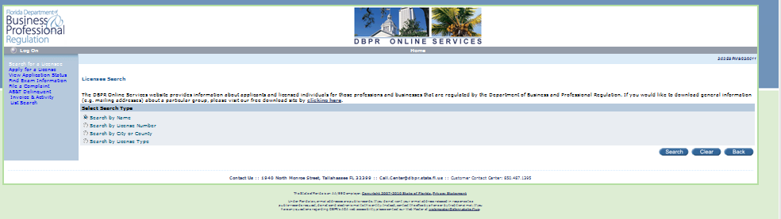
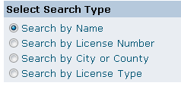
MyFloridaLicense.com
1. Select Search by Name
2. Press the “Search” button
Notes:
From this next page the user can search by name, license number, city or county or license type.

Slide 79
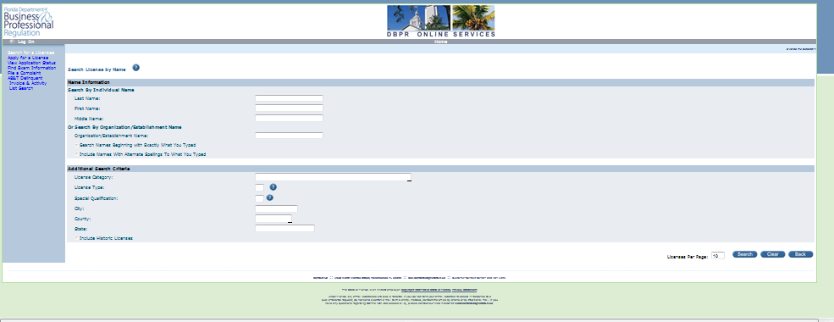
Individual
Search by Individual Name
Last Name:
First Name:
Middle Name:
Company
Search by Organization/Establishment Name
Organization/Establishment :
Name:
The search may be by either individual’s name or by the company name.
Notes:
The user has the choice of searching by either the individual’s name or the company name.

Slide 80
Wind Mitigation Insurance Benefits and
The Florida Office of Insurance Regulation

Slide 81
Wind Mitigation Insurance Benefits
Not only is there a life-safety element to protecting your home against wind and water damage, there can be financial rewards as well.
Homeowners may qualify for insurance premium discounts and credits by having their home evaluated by a licensed home inspector or contractor utilizing the Office of Insurance Regulation Mitigation Verification Inspection Form, Form 1802.
This inspection includes many of the mitigation techniques demonstrated in this presentation.
Notes:
Not only is there a life safety element in protecting your home against wind and water damage there may be financial rewards as well.
Homeowners may qualify for insurance premium discounts or credits by having their home evaluated by properly licensed inspector utilizing the office of insurance regulation mitigation verification inspection form 1802.
The inspection includes many of the mitigation techniques that have been demonstrated in this presentation.

Slide 82
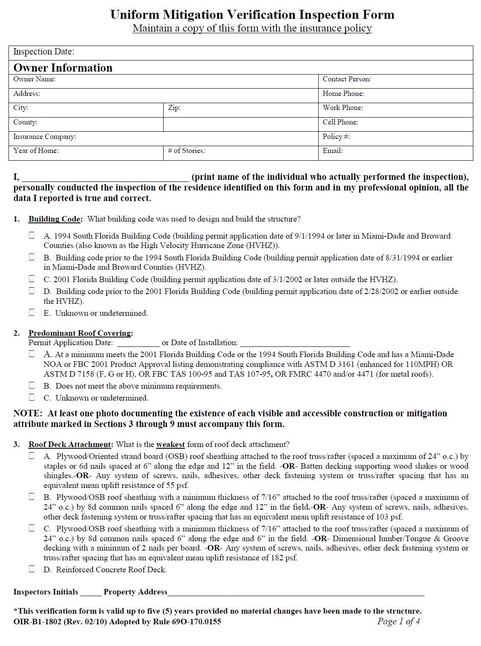
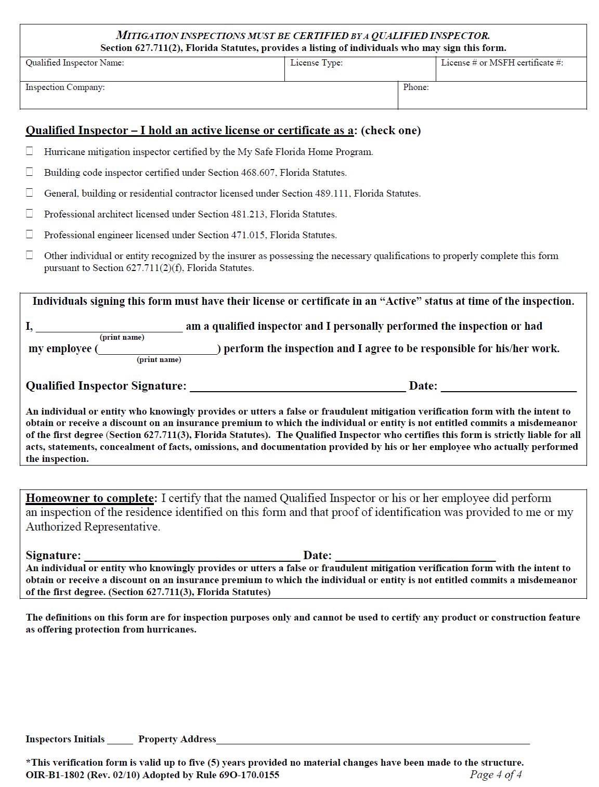
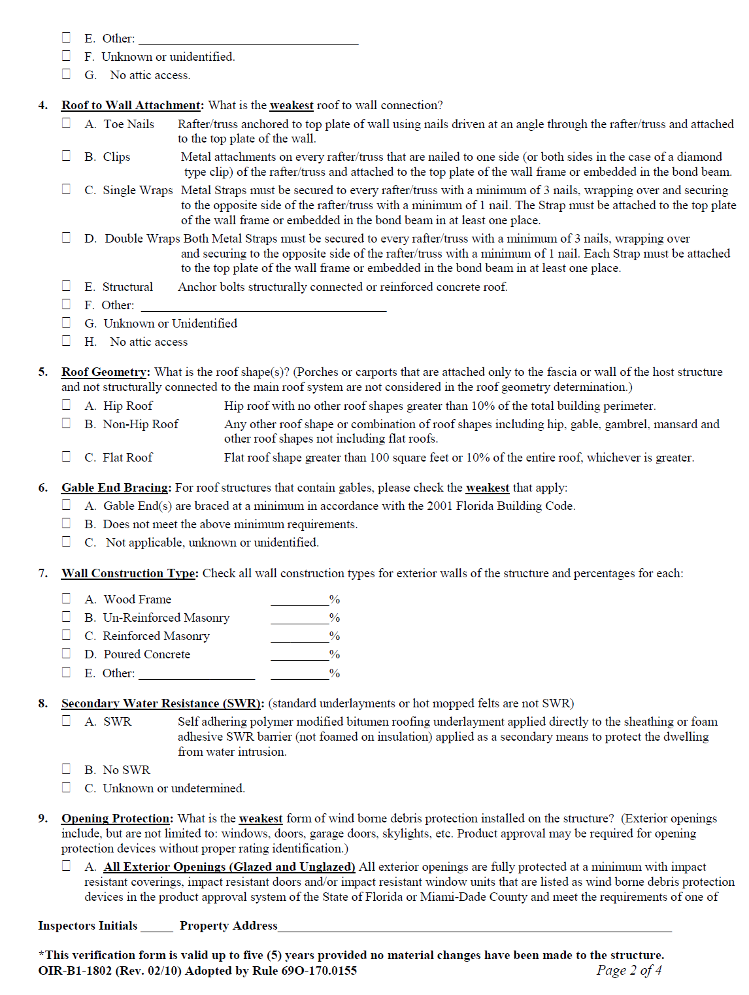
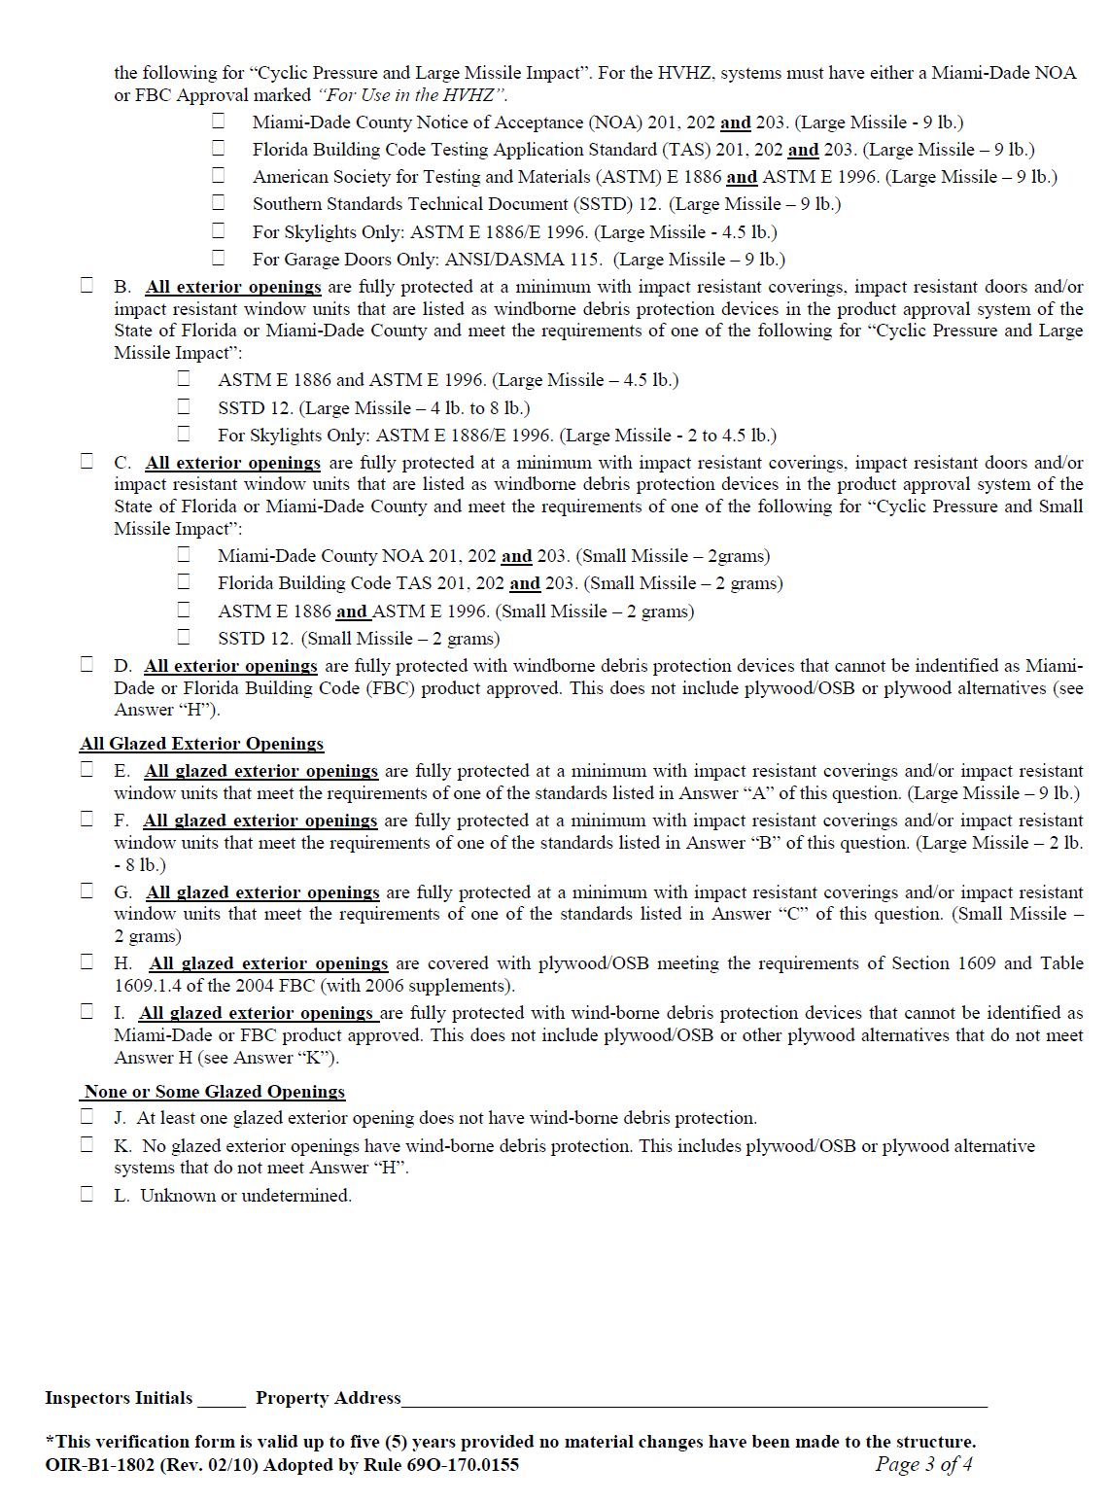
Wind Mitigation Inspection Form OIR-B1-1802
Notes:
The Form 1802 is a 4-page inspection report that can be used by the home owner to verify qualification for insurance discounts by indicating their home has construction features that will potentially reduce the property’s damage in a wind storm.

Slide 83
Mitigation Insurance Discounts & Credits
Homeowners may compare insurance rates by visiting the Consumers Homeowners Insurance Comparison Electronic System (CHOICES) website.
http://www.floir.com/choices/
On the home page of the website there are 2 choices-- one for homes built before 2001 and one for those built after 2001.
On the next page, select the county in which you reside and the display will show a list of all of the companies providing insurance in the county and their base rates. The base rates are reflective of either a $150,000 home built prior to 2001 or a $300,000 home built post-2001.
The site shows the maximum discount offered by each insurance company if all of the mitigation credits are met.
Notes:
Homeowners may compare insurance rates at the Consumer Homeowners Insurance Comparison Electronic System website (CHOICES).
On the homepage of the website you will have two choices—for houses built before 2001 and those built after the Florida Statewide Building Code was put in place.
On the next page you select the county in which you are located and based on whether the home was built before or after 2001, the basic insurance rates by company are listed. Additionally the maximum discount offered by each insurance company is reflected in a table.

Slide 84

$150,000 Value – Pre 2001 Construction
$300,000 Value – New Construction
Notes:
If we click on the $150,000 value pre-2001 construction we get a new screen (CLICK)

Slide 85
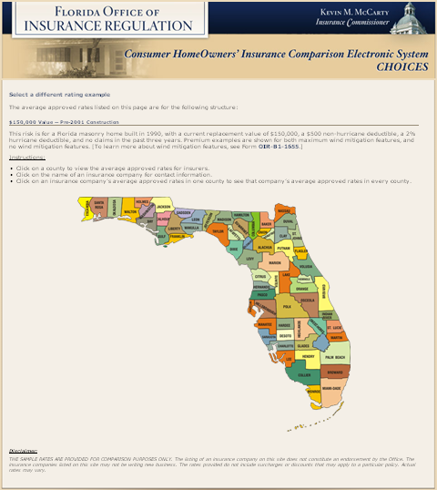
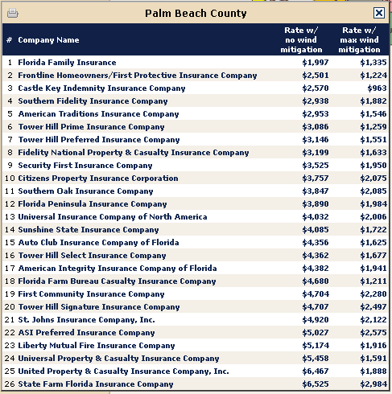
Notes:
On the new screen we see a map of the state of Florida and the user will select the county they wish to review and (CLICK)
In in the example, Palm Beach County was selected. The pop-up window identifies insurance companies that are providing insurance in Palm Beach along with the base rate and the maximum discount rate if all mitigation practices have been observed during the inspection.

Slide 86
Property Assessed Clean
Energy Program
(PACE)

Slide 87
Property Assessed Clean Energy Program
In 2010, the Florida Legislature enacted the Property Assessed Clean Energy (PACE) Program which allows local governments to fund storm-resistance improvements for homeowners that are repaid through property tax assessments. Check with your local government to inquire about PACE.
"Qualifying improvement" includes any:
1. Energy conservation and efficiency improvements;
2. Renewable energy improvements; and,
3. Wind-resistance improvements.
Notes:
In 2010, the Florida Legislature enacted the Property Assessed Clean Energy (PACE) Program which allows local governments to fund storm-resistance improvements for homeowners that are repaid through property tax assessments. Check with your local government to inquire about PACE.
"Qualifying improvement" includes any:
1. Energy conservation and efficiency improvements;
2. Renewable energy improvements; and,
3. Wind-resistance improvements.

Slide 88
3. Wind resistance improvements, include but are not limited to:
a. Improving the strength of the roof deck attachment;
b. Creating a secondary water barrier to prevent water intrusion;
c. Installing wind-resistant shingles;
d. Installing gable-end bracing;
e. Reinforcing roof-to-wall connections;
f. Installing storm shutters; or
g. Installing opening protections.
Notes:
3. Wind resistance improvements, include but are not limited to:
a. Improving the strength of the roof deck attachment;
b. Creating a secondary water barrier to prevent water intrusion;
c. Installing wind-resistant shingles;
d. Installing gable-end bracing;
e. Reinforcing roof-to-wall connections;
f. Installing storm shutters; or
g. Installing opening protections.

Slide 89
Disaster Contractors Network

Slide 90

Home page of the “Disaster Contractors Network” is a resource for homeowner’s before and after a wind storm.
Check on the “General Public” button to get more information.
Notes:
Home page of the “Disaster Contractors Network” is a resource for homeowner’s before and after a wind storm.
Check on the “General Public” button to get more information.

Slide 91


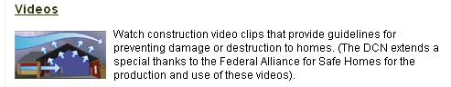
Resources
 | Search the DCN databases for a contractor, vendor, labor provider, or other professional to help you prepare for or recover from a disaster.
‘The Public” page provides links to
Information citizens will find useful.
Videos
Watch construction video clips that provide guidelines for preventing damage or destruction to homes.

Slide 92
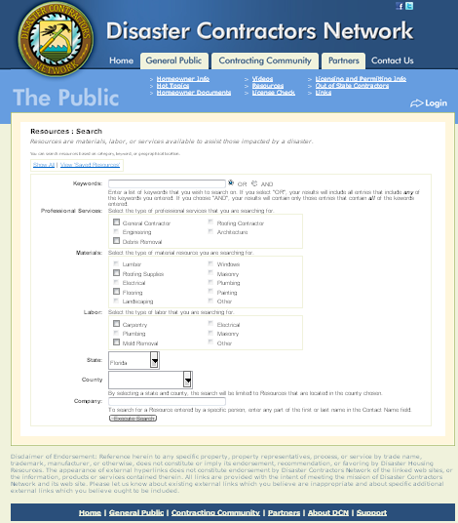
General Resources Page
User can search by:
Keywords:
Professional Services:
General Contractor Roofing Contractor
Engineering Architecture
Debris removal
Materials:
Lumber Windows
Roofing Supplies Masonry
Electrical Plumbing
Flooring Painting
Landscaping Other
Labor :
Carpentry Electrical
Plumbing Masonry
Mold Removal Other

Slide 93
General Resources Page
User can search by:
Keywords:
Professional Services:
General Contractor |  | Roofing Contractor
Engineering |  | Architecture
Debris removal
Materials
Lumber |  | Windows
Roofing supplies |  | Masonry
Electrical |  | Plumbing
Mold removal |  | Other

Slide 94
Resources

Slide 95

Resources:
Click on “For Consumers” Button
Notes:
Shown the Florida home Builders Association website home page. Clicking on the “For Consumers” button will take you to the resources page where there are a number of websites and documents for additional information on hurricane protection and mitigation measures for the homeowner.

Slide 96
Additional Resources
Florida Division of Emergency Management:
www.floridadisaster.org
Preparedness Checklist: www.fdem-mediacenter.org/PDF/EmergencyPreparednessCheclist.pdf
Family Disaster Plan: www.fdem-mediacenter.org/PDF/FamilyDisasterPlan.pdf
Family Disaster Supplies: www.fdem-mediacenter.org/PDF/FamilyDisasterSupplies.pdf
Tips for Evacuating Vulnerable Populations: www.floridadisaster.org/documents/Tips%20for%20Evacuating%20Vulnerable%20Populations.pdf
Notes:
Additional Resources:
Florida Division of Emergency Management:
www.floridadisaster.org
Preparedness Checklist: www.fdem-mediacenter.org/PDF/EmergencyPreparednessCheclist.pdf
Family Disaster Plan: www.fdem-mediacenter.org/PDF/FamilyDisasterPlan.pdf
Family Disaster Supplies: www.fdem-mediacenter.org/PDF/FamilyDisasterSupplies.pdf
Tips for Evacuating Vulnerable Populations: www.floridadisaster.org/documents/Tips%20for%20Evacuating%20Vulnerable%20Populations.pdf

Slide 97
Additional Resources
Federal Emergency Management Agency (FEMA)
“Avoiding Hurricane Damage”- A Checklist for Homeowners: www.fema.gov/library/viewRecord.do?id+3340
“Home Builder’s Guide to Coastal Construction Technical Fact Sheet Series:” www.fema.gov/rebuild/mat/matfema499.shtm
FEMA Fact Sheet 19:”Roof Underlayment for Asphalt Shingle Roofs:” www.mscoastalmapping.com/PDF/hgccfact19.pdf
Notes:
Additional Resources
Federal Emergency Management Agency (FEMA)
“Avoiding Hurricane Damage”- A Checklist for Homeowners: www.fema.gov/library/viewRecord.do?id+3340
“Home Builder’s Guide to Coastal Construction Technical Fact Sheet Series:” www.fema.gov/rebuild/mat/matfema499.shtm
FEMA Fact Sheet 19:”Roof Underlayment for Asphalt Shingle Roofs:” www.mscoastalmapping.com/PDF/hgccfact19.pdf

Slide 98
Additional Resources
Institute for Business & Home Safety
“A Homeowner’s Guide to Hurricane Retrofit:” www.nhc.noaa.gov/HAW2/pdf/hurricaneretrofit.pdf
Gable-end Bracing: www.disastersafety.org/project?projectId=4297
Gable-end Bracing Overhangs: www.disastersafety.org/project?projectId-4036
Federal Alliance for Safe Homes—FLASH
There are a number of informative “DIY” videos relating to hurricane preparation and mitigation practices. www.flash.org/perilhurricanes.php
Notes:
Additional Resources
Institute for Business & Home Safety
“A Homeowner’s Guide to Hurricane Retrofit:” www.nhc.noaa.gov/HAW2/pdf/hurricaneretrofit.pdf
Gable-end Bracing: www.disastersafety.org/project?projectId=4297
Gable-end Bracing Overhangs: www.disastersafety.org/project?projectId-4036
Federal Alliance for Safe Homes—FLASH
There are a number of informative “DIY” videos relating to hurricane preparation and mitigation practices. www.flash.org/perilhurricanes.php

