Slide 1
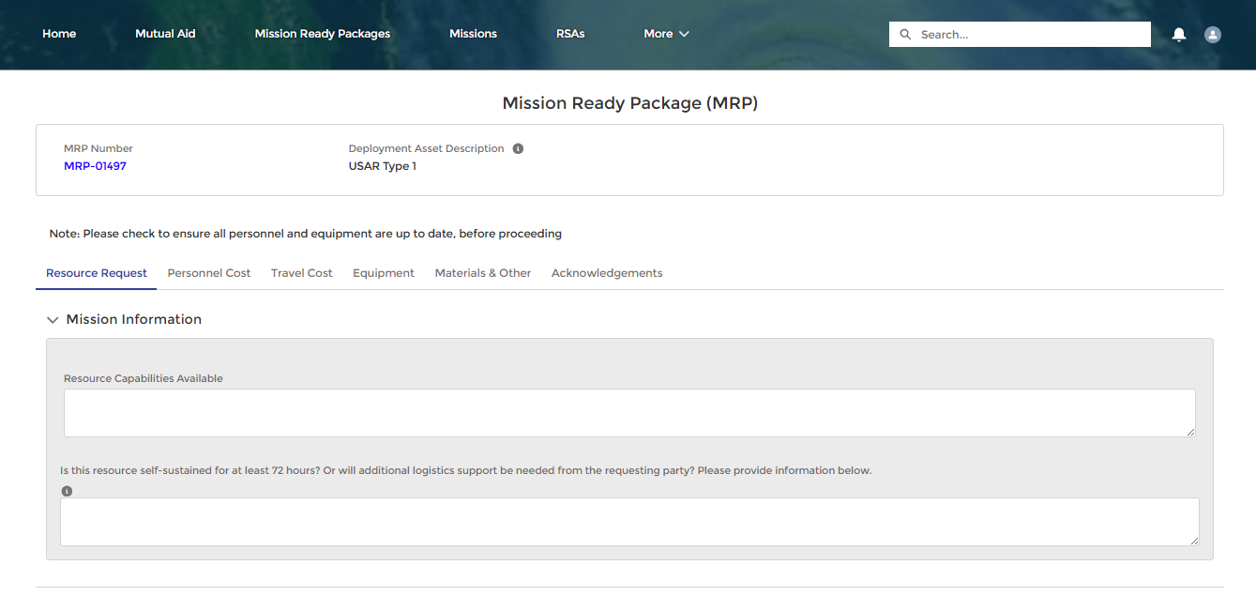
Mission Ready Packages
Establishing a new Mission Ready Package
Mission Ready packages (MRPs) are pre-made templates used to quickly create Resource Support Agreements (RSAs). MRPs can be created and managed in DEMES and ready for use in a mission.
Creating a New Mission Ready Package
How to:
Select Mission Ready Packages from the DEMES Mutual Aid portal from the top navigation bar.
Select Create New MRP.
Enter in a description of the deployment type. Ex. Engine Strike Team
1
2
3
Completing a New Mission Ready Package
How to:
Complete each section (tab) of the MRP.
You will confirm the information specific to each section, adding info where needed, and select Save Tab on each.
1
2
Access the Mutual Aid Portal in DEMES
Establish & Populate a Mission Ready Package
Manage/Modify Mission Ready Package
Create an RSA from Existing Mission
Ready Packages
Mutual Aid Partner Completes & Submits RSA

Slide 2
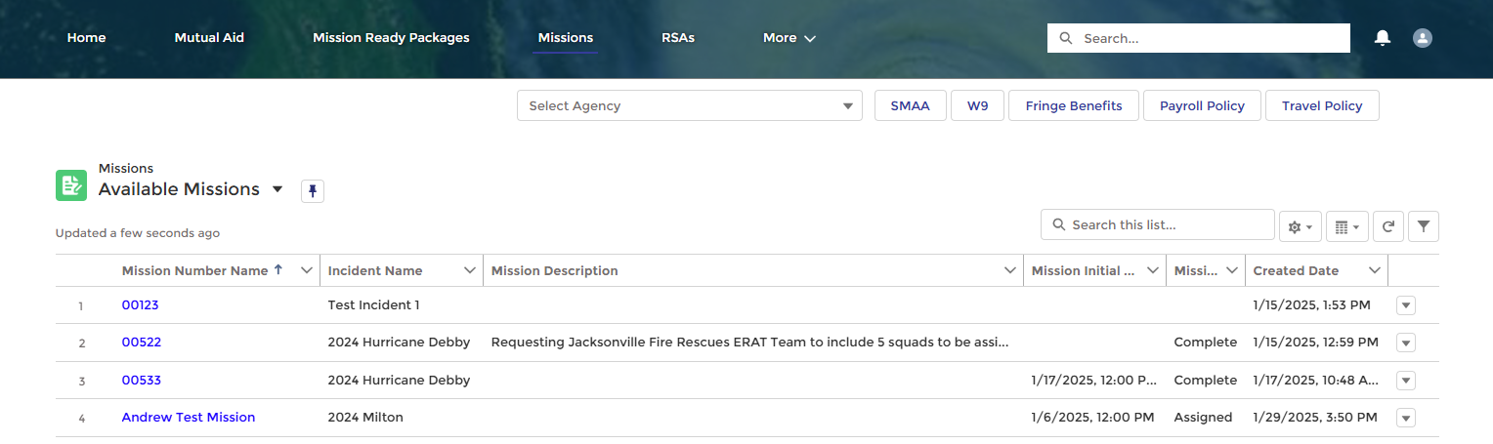
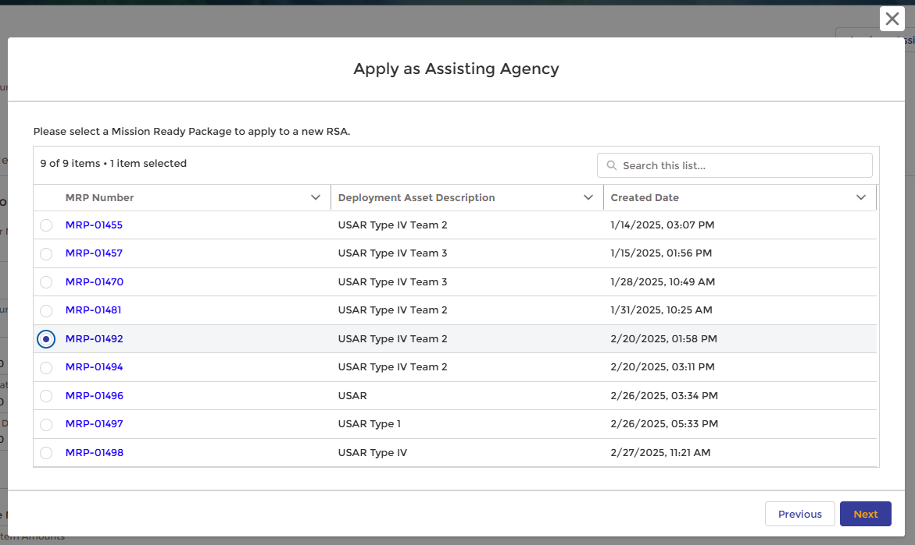
Mission Ready Packages
Creating an RSA from a Mission Ready Package
Once MRPs are established, a user can quickly create an RSA by selecting which parts of the MRP template to use to populate the new RSA.
Creating a new RSA from a Mission Ready Package
How to:
Select Missions from the header bar.
Choose an available Mission by selecting the Mission hyperlink.
Select Apply as Assisting Agency once the Mission details page is open.
Select Yes in the pop-up box to use an MRP when creating your RSA.
Select Next.
Choose the MRP you would like to use.
Select Next.
Choose which Tab you want to clone items from and slide the toggle button to Active to select.
Select Next.
The RSA will then be populated and ready for the user to complete.
1
2
3
4
5
6
7
8
9
REMINDER: Resource Support Agreements (RSAs) are due within 10 days of asset mobilization. Establish a library of MRPs to help you complete them faster!

Slide 3
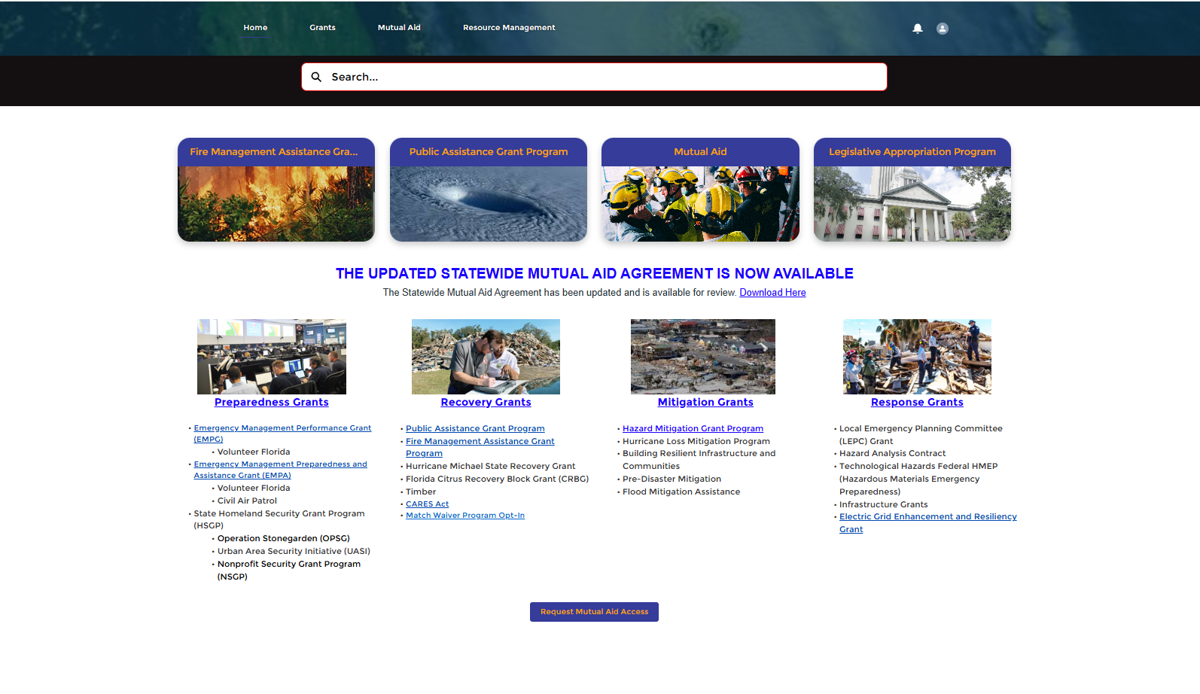
Mutual Aid Access Request
Requesting Access to the Mutual Aid Portal
DEMES users who do not currently have Mutual Aid portal access, can now request it through a button on the FDEM portal homepage.
Requesting Mutual Aid Portal Access
How to:
From the DEMES home page, scroll to the bottom and select Request Mutual Aid Access.
A text box will appear at the top of the screen. Type in your reason for request (required field).
Click Submit.
A confirmation message will appear indicating your request has been submitted to FDEM. Click Close to exit.
Users will receive a notification of approval status via email.
1
2
3
4
Which users should have Mutual Aid portal access?
Authorized Representatives
Financial POCs
Mutual Aid POCs

Slide 4
Mutual Aid | Spring 2025 Enhancements
Key Updates
Enhancements to the Mutual Aid Portal
Updates have been made to the Mutual Aid Portal in DEMES that aim to enhance the user experience through both new and improved functionality ​
Mission Ready Packages - Mission Ready packages (MRPs) are pre-made templates used to quickly create Resource Support Agreements (RSAs). MRPs can be created and managed in DEMES and ready for use in a mission.
Auto-generated RSAs – A draft RSA will be created upon mobilization initiation
Equipment Catalog – FPOCs can now view and manage all equipment associated with their agency within the Equipment Catalog
Contact Management – A Contacts tab has been added to more easily view and manage agency contacts
Email Reminders for Claims and RSAs – Mutual Aid Partners will now receive email notifications at mobilization and demobilization for claims and RSAs.
Edit Access for FPOCs – FPOCs can now see and edit activity records from the Mutual Aid portal
BENEFITS
Simplified processes to complete your work faster
Centralized views and data to make organizing easier
Proactive alerts and visibility to keep you mission-ready
Improved data integrity to improve efficiency and reduce the potential for errors

Slide 5
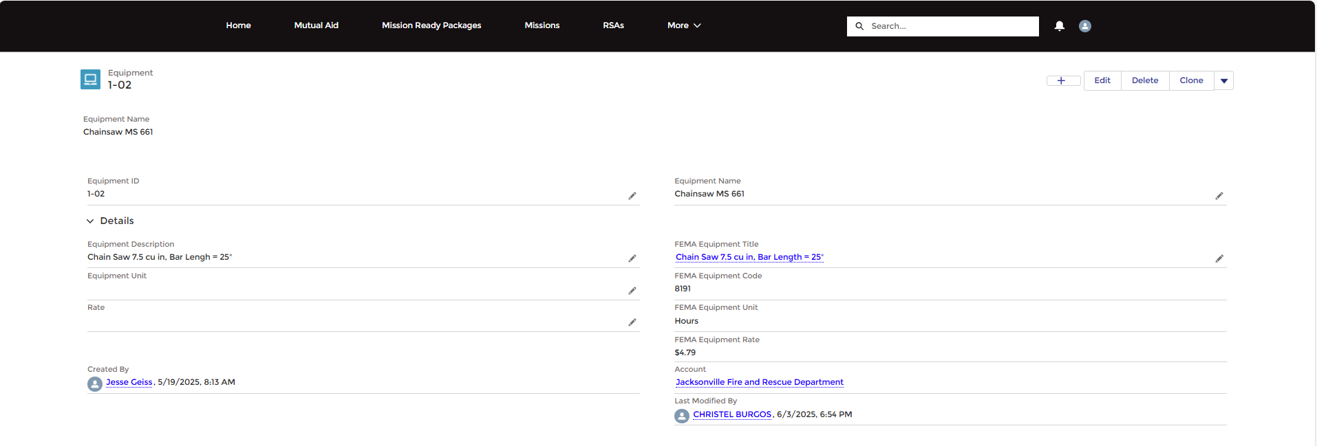
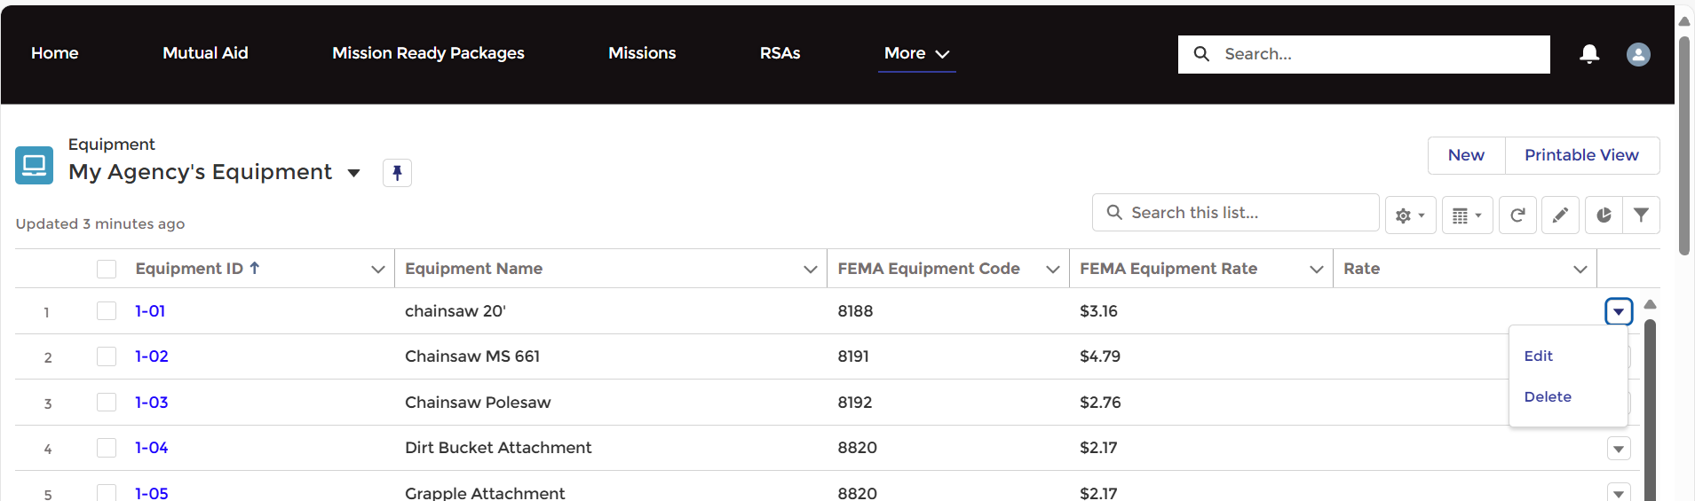
Mutual Aid
Managing Your Agency's Equipment Catalog
Mutual Aid Users can now view and manage all equipment associated with their agency within the equipment catalog in the Mutual Aid portal.
Viewing the Equipment Catalog
How to:
From the Mutual Aid Portal, navigate to the more tab and select Equipment from the drop-down list.
The My Agency Equipment page will be displayed
1
2
Managing the Equipment Catalog
Components
The My Agency Equipment page displays all equipment associated to the agency
Users can manage individual equipment records by selecting the Equipment ID hyperlink
Edit or Delete individual pieces of equipment via the drop-down
1
2
Equipment Ids should be unique to your agency's equipment. Agencies should align internally to ensure the Equipment Id is known by all agency team members to ensure consistency for their records
3

Slide 6
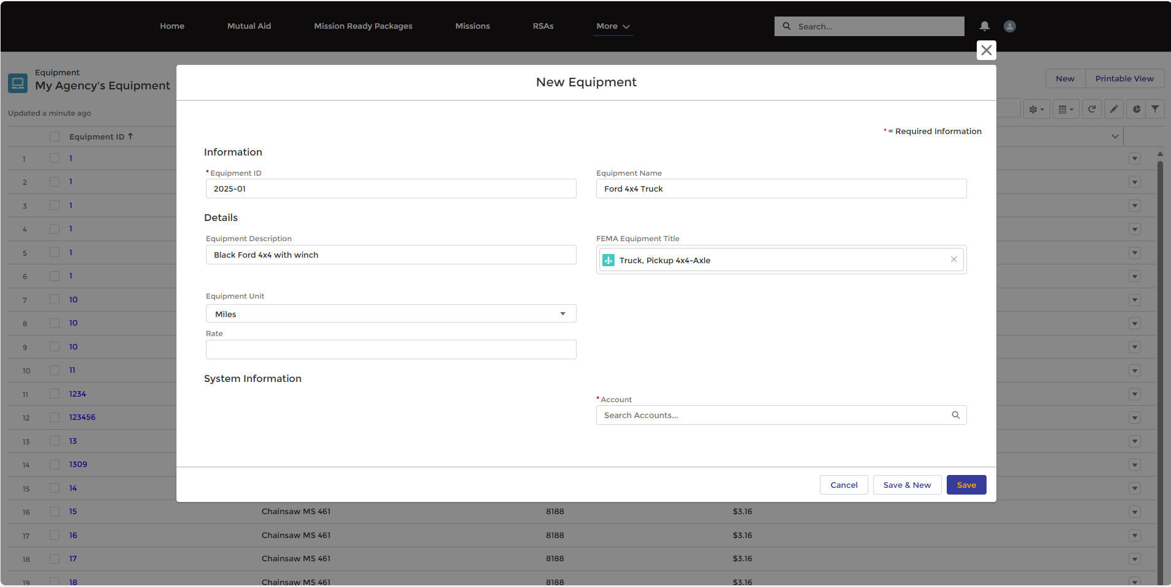
Mutual Aid
Creating an Agency's Equipment Catalog
Agency’s can now add and manage equipment within their equipment catalog in the Mutual Aid portal.
Adding a New Piece of Equipment to an Agency’s Catalog
How to:
From the My Agency’s Equipment page, select New
The New Equipment pop-up will appear
Complete the Information section
Complete the Details section by adding Equipment Description and if known, FEMA Equipment Title
FEMA Equipment Title is populated from a system list. Search by either the common name or FEMA rate code.
Select the Equipment Unit
Unit options are Miles or Hours
Select the Account (Entity) the equipment should be registered to
Select Save
1
3
2
5
6
7

Slide 7
Version Control
# | Changes | Name | Date
1.0 | New QRG Creation | Slalom | 6.9.25

